Slide 1
File Harvest GUI A learning experience
Andrew Waugh, PROV

Slide 2
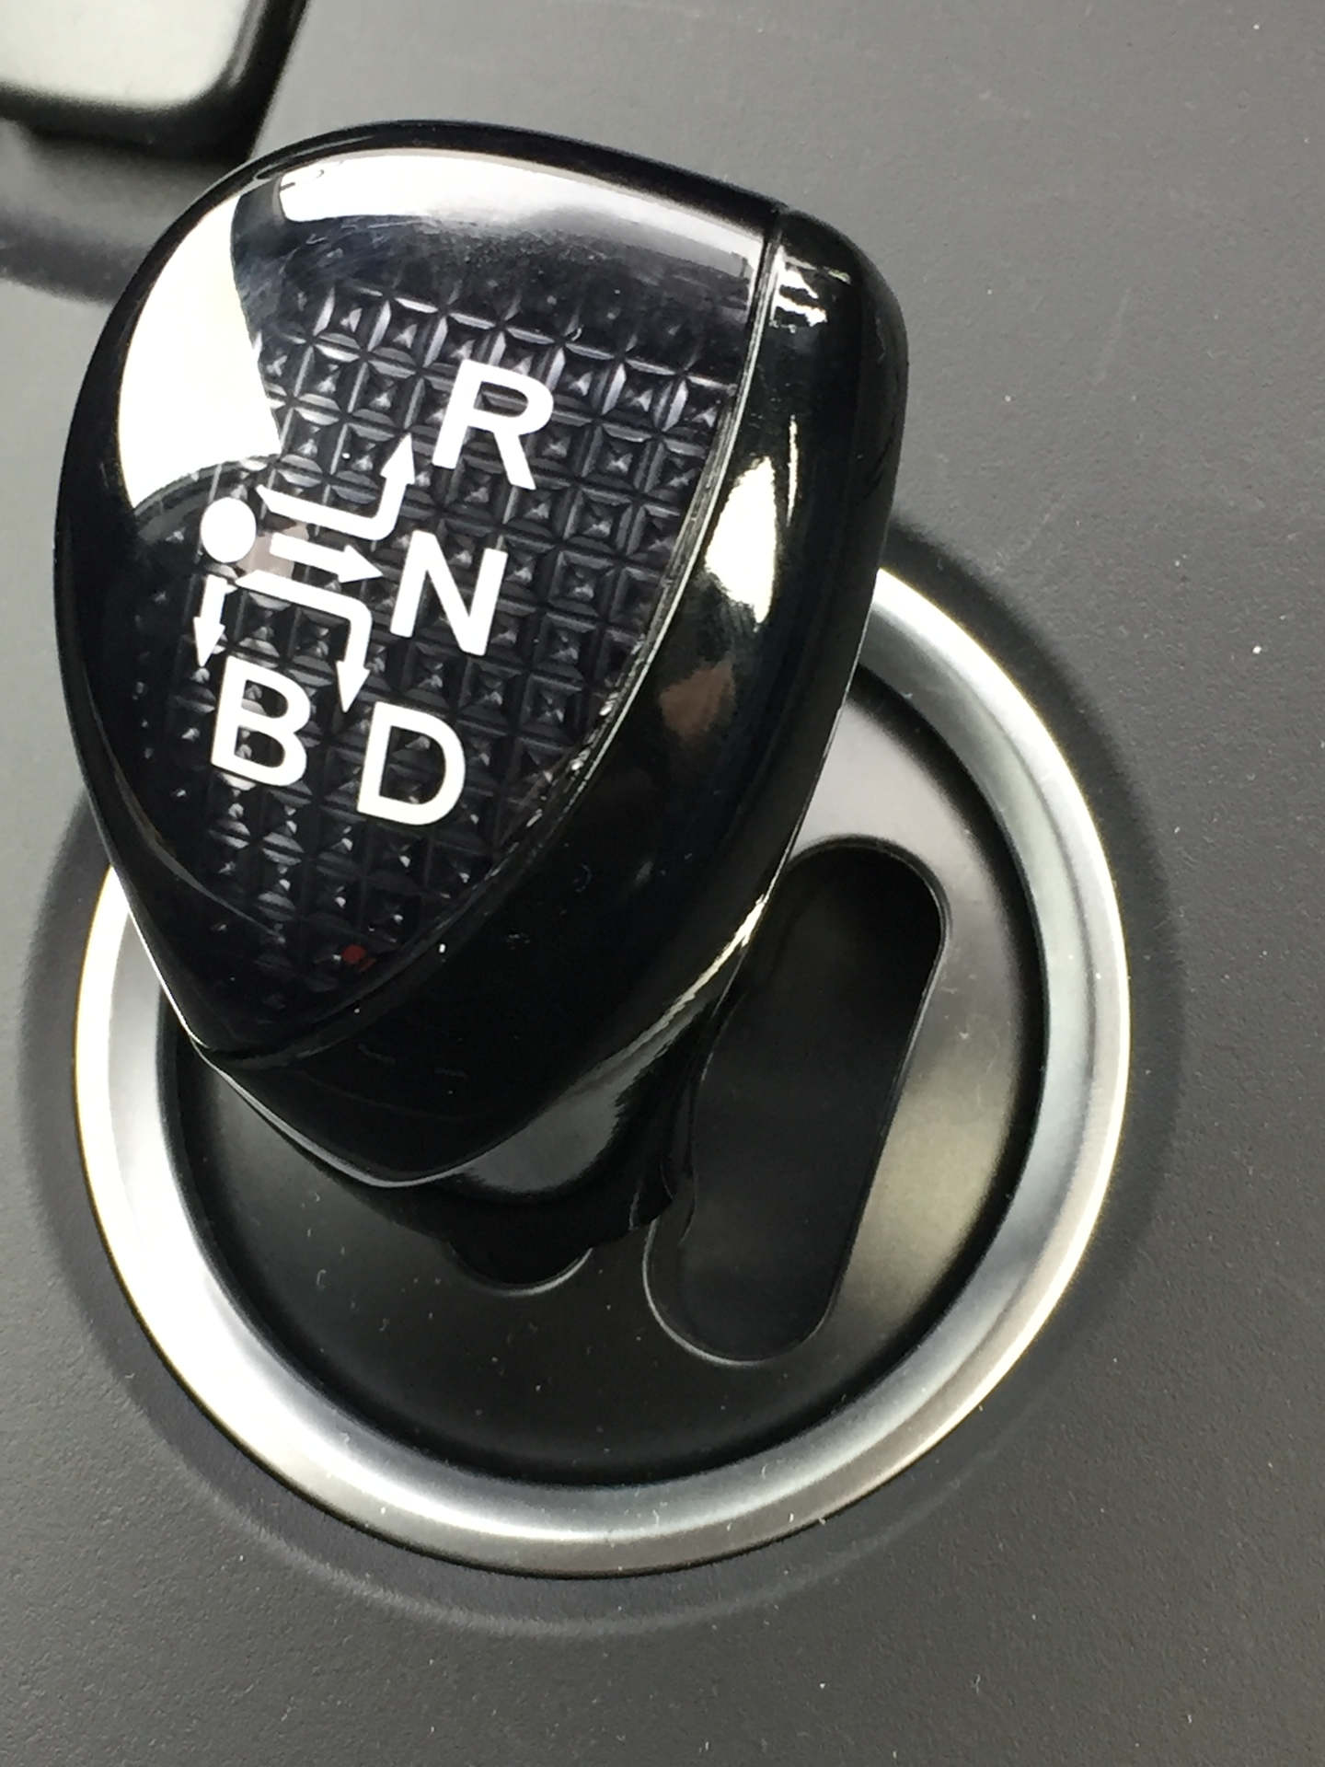
I’ll never be ashamed of my UI again…

Slide 3
Goals of the project
To transfer the knowledge about Java GUI construction into PROV
To build a useful tool for VEO capture
To produce a template for future VEO capture GUIs
To improve the user interface

Slide 4
What is it?
A program that captures a directory in a file system (including its subdirectories) as a V3 VEO

Slide 5
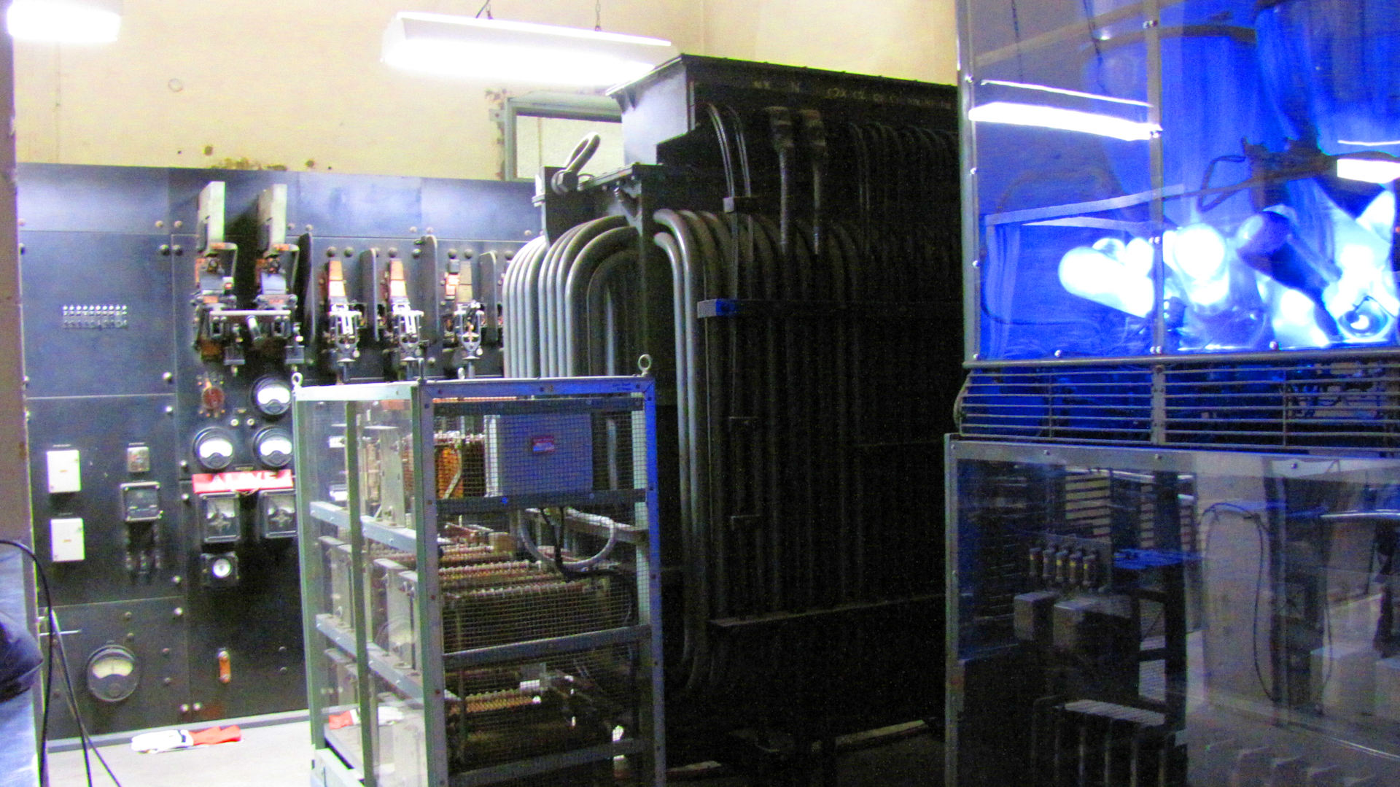
Let’s see it working….

Slide 6
Features of the program
Allows selection of a set of directories to harvest (each directory becomes a VEO)
Allows a selection of branches to be pruned from the harvest (if branches are not of interest)
Allows regular expressions to select files that will not be harvested

Slide 7
Features of the template
Moved the primary VEO controls to the main (splash) screen
Templates, output directory, signer information
Added ability to load and save job templates
Activity is reported as it happens
Reporting of decisions to not include objects
Decision to save Log file can happen at the end of the run

Slide 8
Lessons
GUIs are hard to get right
Code template will help
Experience will help as well

Slide 9
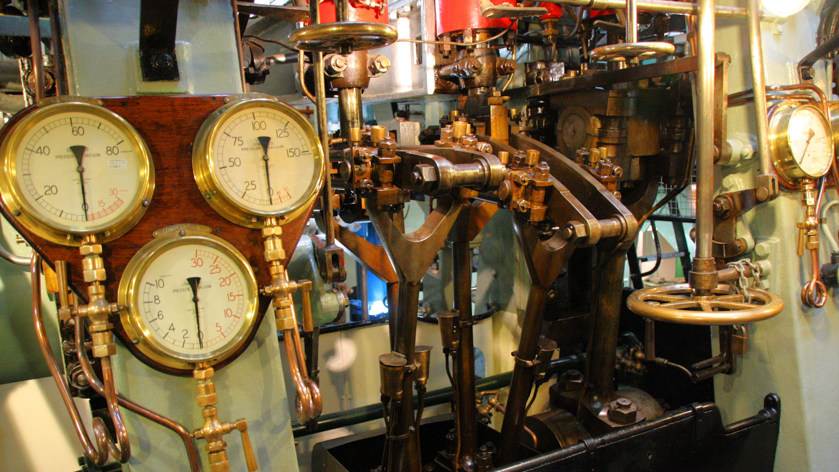
Any questions?

